Slide 1

Bajaj Allianz Hackthon
Create Segments For Insurance Products
Team Members: Namia Mohamed Ali
Kiran Ghadi
Lekha Sharma

Slide 2

Table Of Content
Introduction
How customers buy insurance?
Problem statement
Getting data from public source and data cleaning
Visualization of important features and insights
Conclusion
Business recommendation
References

Slide 3
Introduction
General insurance company formed with a joint venture between Bajaj Finserv Ltd and Allianz SE.
Bajaj Allianz received the insurance Regulatory and Development Authority(IRDA) certificate of Registration on 2nd May,2001 to conduct various businesses in India.
The claim settlement ratio of Bajaj Allianz Life Insurance is 98.48% for the financial year 2021-22 as per IRDAI Annual Report. This is considered a high CSR which means for every 100 claims received, 98 claims are settled.
It continues to be one of the most financially robust insurers in the industry by maintaining its growth as well as profitability.

Slide 4
How customers buy insurance?
For most Indians, insurance agents still are the ones who introduced the concept of life insurance to them, and they remain an important part of customer’s policy purchase decision. But, with or without COVID, trends suggest that India is rapidly shifting to digital channels for purchase of financial products and insurance is not untouched by this phenomenon. Where agent influence remains a dominant influencing factor when it comes to insurance policy purchase, a lot of people are doing their own research and opting for direct purchase from online platforms. In such scenario, it becomes important to understand how they make purchase decision and how they select right policy for themselves.

Slide 5
Problem statement
There are various factors that affect customer’s policy purchase decisions in addition to the vast number of channels - digital or otherwise. In this hackathon we want you to:
Create segments of customers based on their persona. The segments should be defined clearly and should not be too similar to each other,
Evaluate weightage of product features for each of the customer segments created,
Create a recommender systems (statistical based model or algorithm) to find the attributes influencing the customer’s preference for product features
Identify effect of market factors affecting these segments.
Goal
It is your job to correct identify the population segments while clearly defining characteristics of the segment and the preferred product category (top 2) by the constituents of the segments. You are free to use the features that might be relevant. The target variable is "prod_catetogry", which is the insurance product.
The challenge of this hackathon is to perform accurate population segments using the various features specific to the Indian Market. Therefore, the final evaluation will be based on how well defined the clusters/segments are and how accurately your model will determine the insurance product for the segment.

Slide 6
Metric
Classification model build on the data using product category as the target variable.
Accuracy cannot be the measure for model performance since there is great imbalance in the target variable(prod_category).
Customer Segmentation achieved by performing cluster on the data , import features are also achieved.

Slide 7
Getting data from public source and data cleaning
To check how the stock market volatility affect the customer sentiment in buying insurance we have included the NIFTY50 Stock market prices.
AGE has missing values which is imputed by getting the median AGE of each product category.
Data type conversion is done for unique identification(ID) and the other index band and Quality score band.
BFS stock price and nifty50 stock price in converted to numerical value
age is converted to integer type.

Slide 8
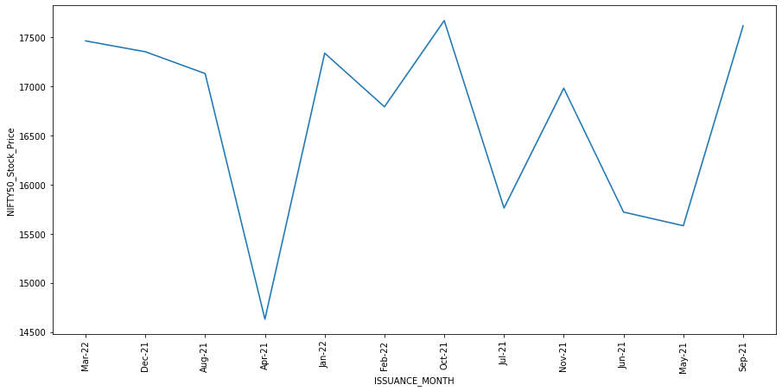
Getting data from public source and data cleaning
the lineplot illustrates that the variation in nifty50 stock price and the bajaj finserv stock price are highly correlated and hence these variables will be dropped in the final model.
The highest stock price is in the month of March in the year 2022
the highest purchase product category is ULIP

Slide 9
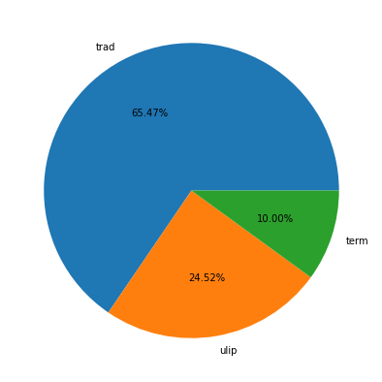
Visualization of important features and insights - Imbalance in data
Product category (Target Variable)
INFERENCE:
We can see there is a large imbalance in the data
This imbalance will cause a problem in prediction in further steps , so we need to get more information about the product category from the insurance company to proceed
Further modelling is done by keeping in mind the limitation due to imbalance in data hence , tree model preferred.

Slide 10
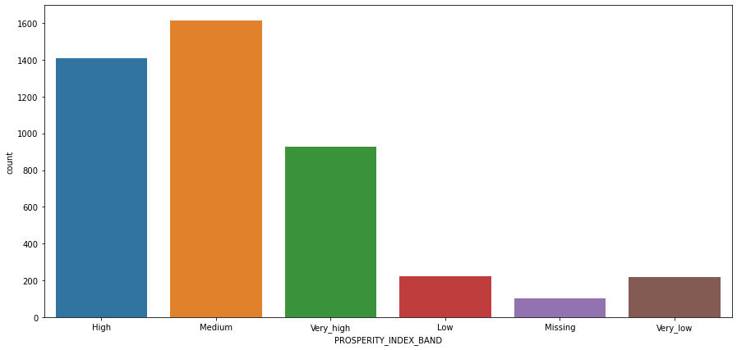
Visualization of important features and insights
INFERENCE:
Prosperity index band indicates the financial status of the people of a particular area

Slide 11
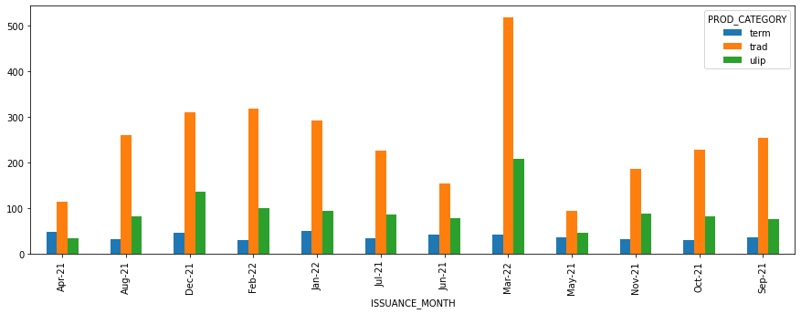
Visualization of important features and insights
MULTIVARIATE ANALYSIS
INFERENCES:
THE CHART ILLUSTRATES THAT MARCH -22 HAS THE HIGHEST NUMBER OF POLICY ISSUED
ulip IS THE MOST PURCHASED POLICY AMONG THE CUSTOMERS
TERM POLICY IS LEAST PURCHASED BY THE POLICYHOLDERS EXCEPT FOR THE MONTH OF AUGUST 21

Slide 12
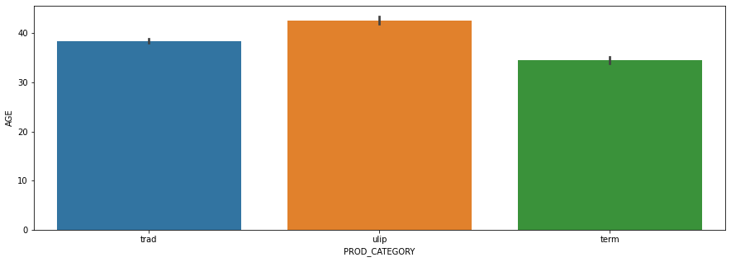
Visualization of important features and insights
Age Vs Product category
INFERENCES:
THE CHART ILLUSTRATES ULIP IS MOSTLY PURCHASED BY PEOPLE OF AVERAGE AGE JUST OVER 40
TRAD IS PURCHASED BY PEOPLE OF AVERAGE AGE NEARING 40
TERM POLICY IS PURCHASED BY THE POLICY HOLDERS OF AVERAGE AGE 35

Slide 13
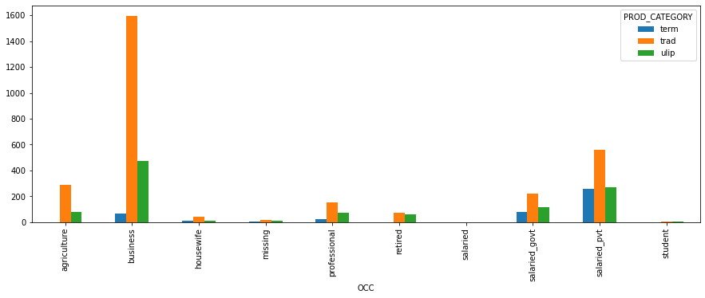
Visualization of important features and insights
Occupation Vs PROD_CATEGORY
INFERENCES:
THE CHART ILLUSTRATES ULIP AND TRADE IS MOSTLY PURCHASED BY PEOPLE OF ALMOST ALL OCCUPATION FROM AGRICULTURE TO BUSINESS
TERM POLICY IS PURCHASED MOSTLY BY BUSINESS MEN AND PRIVATE COMPANY EMPLOYEES

Slide 14
Conclusion
We have found out certain features contributing highly to the customer behaviour towards the insurance such as age, income segment, quality score and prosperity index.
The data is highly imbalance with 65% of product category belonging to ‘ULIP’ , nearly 25% to ‘TRAD’ and the rest to ‘term’ ,Here we need to get more data to make further inference to build the model we have choose tree algorithms and mention the class weight attribute to give priority to all the classes equally.
The final model choose is gradient boosting due to its best performance.
Accuracy cannot be taken as a factor to consider the model fit due to the imbalance , Macro average and precision - recall must be considered for proper inferences.

Slide 15
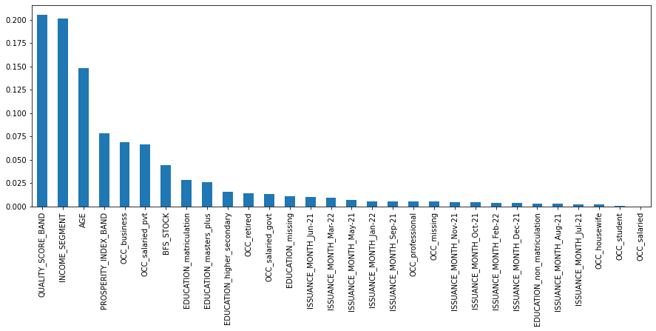
IMPORTANT FEATURES
Quality score band is the score given to each of the policy holder depending on their premium and previous settlement.
AGE is a crucial factor in deciding which type of insurance to be purchased.
Income segment is divided into bands depending on the person’s financial stability
prosperity index helps usto to identify the area where the income of people are higher.

Slide 16
Business recommendation
AGE is an important factor in deciding to buy the policies. People with average age of 40 buys ulip and ulip is the most purchased by the customers,followed by trad which is bought by policyholders of average age slightly over 38. Term is least purchased.
Income segment plays a large role as the financially stable people tend to buy more policies.
Policy holders with a medium level of prosperity index band tends buy more policies and a higher number of trade policies followed by ulip purchased by all categories of people.
In the year of 2022 there is an increase in insurance purchase which indicates policy holders tend to purchase the policies when the market is stable in nature.

Slide 17
References
https://medium.com/analytics-vidhya/categorical-feature-selection-using-chi-squared-test-e4c0d0af6b7e
https://towardsdatascience.com/the-k-prototype-as-clustering-algorithm-for-mixed-data-type-categorical-and-numerical-fe7c50538ebb#:~:text=We%20can%20look%20into%
https://in.investing.com/equities/bajaj-finserv-limited-historical-data?end_date=1647282600&interval_sec=monthly&st_date=1615746600

Slide 18


